Slide 1


M.Tech Program
Advanced Industry Integrated Programs
Jointly offered by University and LTIMindTree
Project Title
PROCURE BOT – Intelligent Procurement and Vendor Quality Assurance Assistant
Team Member
S Syed ali Fathima
Crescent 2025-27
Knowledge partner | Implementation partner

Slide 2
Project Title - Calibri body 18
Introduction
Procurement is a critical business function responsible for sourcing raw materials, components, products, and services from suppliers.
Procurement information is often distributed across purchase orders, vendor records, quotations, invoices, contracts, and policy documents.
Manual information retrieval and vendor evaluation can be time-consuming and may delay procurement decisions.
Vendor quality assurance requires continuous monitoring of supplier delivery performance, defective units, compliance, pricing, and historical performance.
Procure Bot is proposed as an AI-powered RAG-based assistant that enables natural-language procurement queries and provides data-driven insights for vendor evaluation and procurement decision support.

Slide 3
Project Title - Calibri body 18
Objective
To develop an AI-powered procurement assistant for intelligent access to procurement and vendor information.
To enable natural-language querying of purchase orders, supplier records, pricing, delivery, and compliance data.
To evaluate vendor quality and performance using indicators such as defects, delivery performance, and compliance.
To support procurement decision-making through relevant, data-driven insights retrieved using RAG.
To automate procurement assistance tasks, including compliance alerts and generation of RFQ/supplier communication drafts.

Slide 4
Project Title - Calibri body 18
Scope
Pre-Procurement Intelligence – Identify requirements, analyze raw-material needs, evaluate historical purchases, pricing trends, and vendor performance.
Vendor Selection & Procurement – Verify approved vendors, generate RFQs, retrieve quotations, compare suppliers, and support Purchase Order processing.
Compliance & Risk Management – Validate procurement activities against organizational policies, contractual requirements, and compliance standards.
Post-Procurement Monitoring – Track deliveries, analyze defects, evaluate supplier quality and performance, monitor compliance, and recommend vendor reviews.

Slide 5
Project Title - Calibri body 18
Literature Review
S.NO | PAPER TITLE | AUTHOR | YEAR | CONFERENCE/JOURNAL | REFERENCE
1. | Survey of Hallucination in Natural Language Generation | Ziwei Ji, Nayeon Lee, Rita Frieske et al. | 2023 | ACM Computing Surveys | Highlights hallucination risks in generative AI, motivating grounded and evidence-based procurement responses.
2. | A Hybrid Multi-Criteria Decision-Making and Machine Learning Approach for Explainable Supplier Selection | Authors of the study | 2024 | Supply Chain Analytics | Combines machine learning with MCDM to improve explainability in supplier selection.
3. | Enhancing Procurement Processes in Supply Chain Management with Large Language Models | Research authors | 2026 | Procedia Computer Science | Studies LLMs for offer checking, summarization and supplier bid comparison, directly supporting AI-assisted procurement.

Slide 6
Project Title - Calibri body 18
Summary of Literature
Digital Procurement: Existing e-procurement systems improve purchasing efficiency but mainly depend on structured data, predefined workflows, and rule-based processes.
Supplier Evaluation & AI: MCDM, NLP, and machine-learning approaches support supplier selection, performance evaluation, and information retrieval, but often address individual procurement activities.
RAG & LLM Integration: RAG and LLMs enable intelligent, natural-language procurement assistance, but challenges such as data quality, hallucination, and compliance remain—highlighting the need for an integrated Procure-Bot combining retrieval, vendor analysis, and compliance support.
Existing approaches often address supplier selection, procurement analytics, document retrieval, or LLM-based assistance separately.

Slide 7
Project Title - Calibri body 18
Additional Information
AI-powered RAG architecture enables accurate, context-aware responses using relevant procurement data.
Vendor quality assurance evaluates supplier performance based on delivery, defects, compliance, and historical records.
Natural-language interaction allows procurement teams to retrieve information without manually searching multiple documents.
Local AI technologies such as Llama 3.1, Ollama, and Qdrant support a scalable and privacy-conscious architecture.
Future integration can extend the system to ERP platforms, Microsoft Teams, real-time procurement data, and advanced vendor risk analytics.

Slide 8
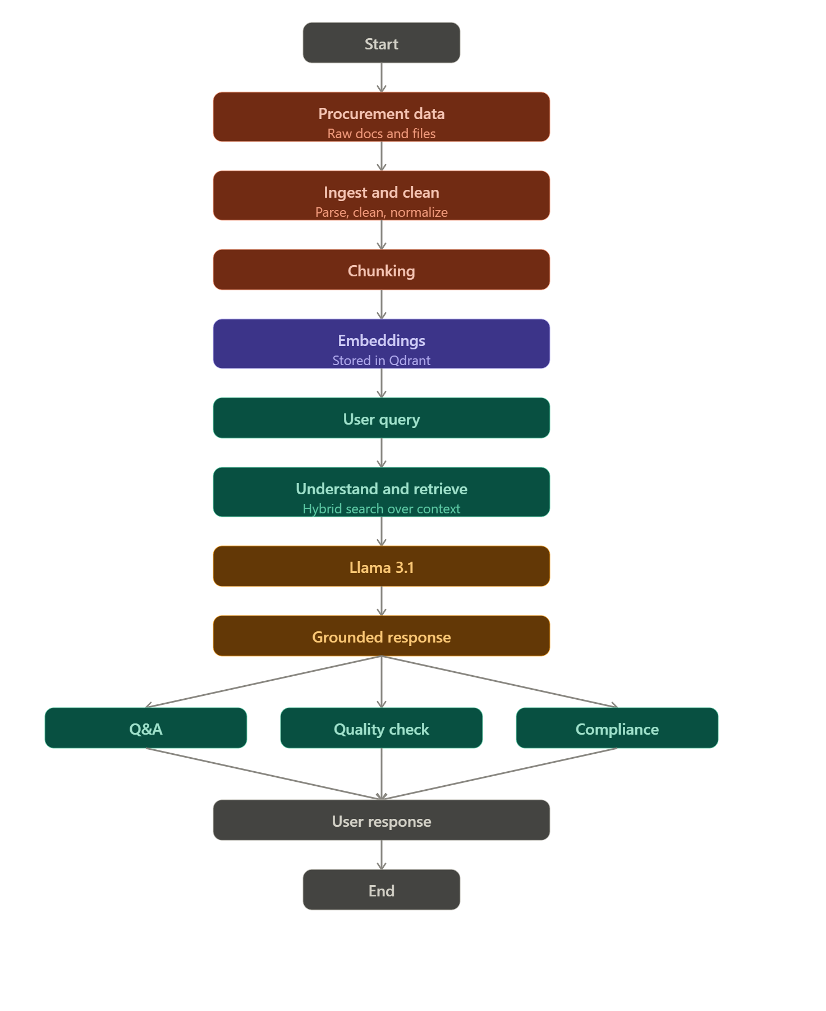
FLOWCHART

Slide 9
Project Title - Calibri body 18
Modules to cover: core intelligence
Data Ingestion & Preprocessing: Collect, clean, normalize, and prepare procurement and vendor data.
Document Processing & Metadata Management: Process structured and unstructured procurement information with relevant metadata.
Embedding & Vector Database: Generate semantic embeddings and store procurement knowledge in Qdrant for efficient retrieval.
RAG-Based Procurement Q&A: Retrieve relevant information and generate context-grounded answers using Llama 3.1.
Natural Language Query Interface: Enable procurement teams to interact with the system using simple, natural-language questions.

Slide 10
Project Title - Calibri body 18
Procurement Intelligence
Vendor Quality Assurance: Evaluate suppliers based on defects, delivery performance, compliance, and historical records.
Procurement Compliance Checker: Identify potential policy violations, approval requirements, and non-compliant procurement activities.
Vendor Performance Analysis: Compare supplier performance and identify vendors requiring review or improvement.
RFQ Generation & Supplier Assistance: Generate structured, ready-to-edit RFQ and supplier communication drafts from procurement requirements.
Procurement Decision Support:Provide actionable insights to help procurement teams make faster and more informed purchasing decisions.

